Slide 1
CSC 480: Artificial Intelligence
Franz J. Kurfess
Professor
Computer Science Department
California Polytechnic State University
San Luis Obispo, CA, U.S.A.

Slide 2
Course Overview
Introduction
Intelligent Agents
Search
problem solving through search
uninformed search
informed search
Games
games as search problems
Knowledge and Reasoning
reasoning agents
propositional logic
predicate logic
knowledge-based systems
Learning
PAC learning
learning from observation
neural networks
Natural Language Processing (NLP)
Conclusions

Slide 3
Chapter Overview NLP
Motivation
Objectives
Introduction NLP
Terminology
Related Areas
Communication
Roles: Speaker, Hearer
Communication Channels
NLP Perspectives
Syntax
Semantics
Pragmatics
Core NLP Issues
Modularity
Ambiguity
NLP Tasks
Syntactic Tasks
Semantic Tasks
Pragmatic Tasks
Related Tasks
Information Extraction
Text Summarization
Machine Translation
Knowledge Acquisition
History of NLP
Important Concepts and Terms
Chapter Summary

Slide 4
Logistics
Introductions
Course Materials
textbook
handouts
Web page
CourseInfo/Blackboard System
Term Project
Lab and Homework Assignments
Exams
Grading

Slide 5
Bridge-In

Slide 6
Pre-Test

Slide 7
Motivation

Slide 8
Objectives

Slide 9
Evaluation Criteria

Slide 10
Introduction NLP
Terminology
Related Areas

Slide 11
Natural vs. Artificial Language
natural languages
primarily used by people
spoken language
written language
evolved over time
frequently with complex, but flexible grammatical structures
artificial languages
designed and created for specific uses
“neutral” language independent of nationalistic or ethnic influences
Esperanto
Lojban
some are primarily intended for computers
programming languages
knowledge representation languages
grammatical structures are often simple, but rigid

Slide 12
Related Areas
Computational Linguistics
use of computational methods in linguistics
Information and Knowledge Extraction
analysis of texts
Formal Languages
artificial languages
emphasis on certain abstract properties
Cognitive Science
language and its use by humans
Machine Learning
acquisition of language properties from data sets

Slide 13
Communication
Roles: Speaker, Hearer
Communication Channels

Slide 14
Communication
exchange of information between two or more participants
requires a common communication infrastructure and method
communication channel(s)
infrastructure for the information exchange
physical communication medium
sound over the air for spoken language
alphabet
set of symbols comprehensible to speaker and hearer
language
method for constructing longer sequences of symbols for richer and more effective communication
discourse
conventions and rules about behavior during communication

Slide 15
Communication: Speaker
Intention
Generation
Synthesis

Slide 16
Communication: Hearer
Perception
Analysis
Incorporation

Slide 17
Transfer of Knowledge
Communication
Basic Concepts
Language and Communication
Natural Language
Formal Languages
Communication Models

Slide 18
Basic Concepts
communication
exchange of information
requires a shared system of signs
greatly enhanced by language
speaker
produces signs as utterances
general: not only spoken language
listener (hearer)
perceives and interprets signs

Slide 19
Purpose of Communication
sharing of information among agents or systems
query other agents for information
responses to queries
requests or commands
actions to be performed for another agent
offer
proposition for collaboration
acknowledgement
confirmation of requests, offers
sharing
of experiences, feelings

Slide 20
Communication Problems
intention
what is the expected outcome (speaker’s perspective)
timing
when is a communication act appropriate
selection
which act is the right one
language
what sign system should be used
interpretation
will the intended meaning be conveyed to the listener
ambiguity
can the intention be expressed without the possibility of misunderstandings

Slide 21
Language and Communication
Natural Language
used by humans
evolves over time
moderately to highly ambiguous
Formal Languages
invented
rigidly defined
little ambiguity

Slide 22
Natural Language
formal description is very difficult
sometimes non-systematic, inconsistent, ambiguous
mostly used for human communication
easy on humans
tough on computers
context is critical
situation, beliefs, goals

Slide 23
Formal Languages
symbols
terminal symbols
finite set of basic words
not: alphabet, characters
non-terminal symbols
intermediate structures composed of terminal or non-terminal symbols
strings
sequences of symbols
phrases
sub-strings grouping important parts of a string

Slide 24
Formal Languages Cont.
sentences
allowable strings in a language
composed from phrases
grammar
rules describing correct sentences
often captured as rewrite rules in BNF notation
lexicon
list of allowable vocabulary words

Slide 25
Communication Models
encoded message model
a definite proposition of the speaker is encoded into signs which are transmitted to the listener
the listener tries to decode the signs to retrieve the original proposition
errors are consequences of transmission problems
situated language model
the intended meaning of a message depends on the signals as well as the situation in which they are exchanged
mis-interpretation may lead to additional problems

Slide 26
Communication Types
telepathic communication
speaker and listener have a shared internal representation
communication through Tell/Ask directives
language-based communication
speaker performs actions that produce signs which other agents can perceive and interpret
communication language is different from the internal representation
more complex
involves several mappings
language needs to be generated, encoded, transmitted, decoded, and interpreted

Slide 27
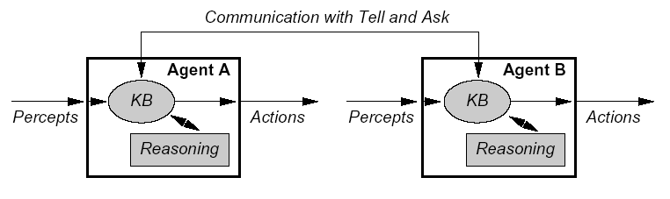
Telepathic Communication
[Russell & Norvig 1995]

Slide 28
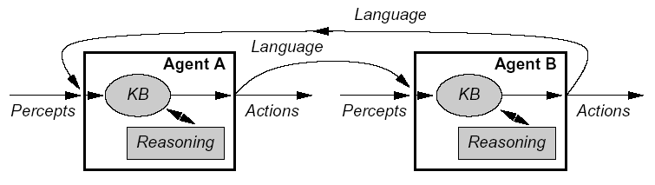
Language-Based Communication
[Russell & Norvig 1995]

Slide 29
Communication Steps: Speaker
intention
decision about producing a speech act
generation
conversion of the information to be transferred into the chosen language
synthesis
actions that produce the generated signs

Slide 30
Communication Steps: Hearer
perception
reception of the signs produced by the speaker
speech recognition, lip reading, character recognition
analysis
syntactic interpretation (parsing)
semantic interpretation
disambiguation
selection of the most probable intended meaning
incorporation
the selected interpretation is added to the existing world model as additional piece of evidence

Slide 31
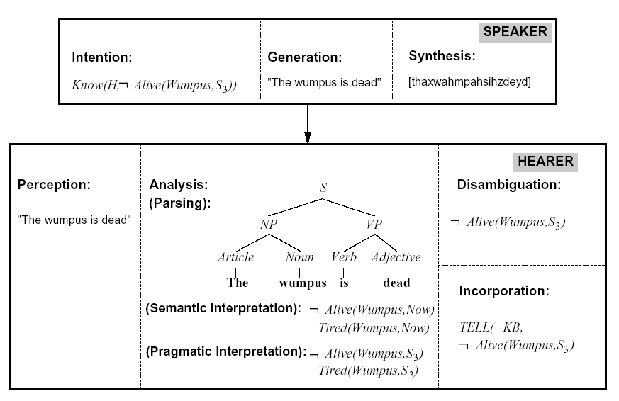
Communication Example
[Russell & Norvig 1995]

Slide 32
NLP Perspectives
NLP Levels
Syntax
Semantics
Pragmatics

Slide 33
NLP Levels
Discourse Processing
Semantic Interpretation
Syntactic Analysis
Morphological Analysis
Phonetic Analysis
OCR, Tokenization
Speech
Text

Slide 34
Syntax
arrangement of words into longer structures
phrases
sentences
specified by a grammar
set of rules about admissible structures
see also syntax check in programming languages
natural languages are difficult to fully describe through a grammar
in particular spoken languages
helps resolve the meaning of words
place or role in a sentence

Slide 35
Semantics
meaning of structures
words
phrases
sentences
sometimes specified by (formal) interpretations
mappings of words and phrases to meanings
may not be practical for natural languages
difficult to capture for computers

Slide 36
Pragmatics
context and social structures of a communication
provides additional help with the interpretation

Slide 37
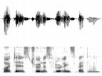
NLP Levels
contextualized meaning
Discourse Processing
literal meaning
Semantic Interpretation
parse trees
Syntactic Analysis
words
Morphological Analysis
Phonetic Analysis
OCR, Tokenization
Speech
sound waves
images, characters
Text

Slide 38
Core NLP Issues
Modularity
Ambiguity

Slide 39
Modularity
compositionality is desirable
isolated processing of smaller building blocks
assembly of larger blocks from smaller ones
possible for some (artificial) languages
context-free languages
very limited in natural language
context is required for interpretation of words, phrases, sentences, paragraphs, …
sometimes even for morphological analysis

Slide 40
Ambiguity
multiple meanings for one structure
word, phrase, sentence, paragraph, …
inherent in all natural languages
often used for creative purposes
e.g. poetry, puns
disambiguation is needed
determines the intended meaning
usually dependent on the context
semantic
pragmatic
may require “world knowledge” or “commonsense reasoning”

Slide 41
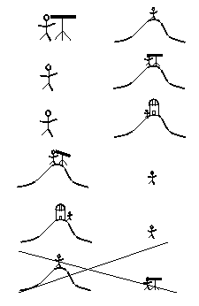
Ambiguity Examples
Natural language is highly ambiguous and must be disambiguated.
I saw the man on the hill with a telescope.
I saw the Grand Canyon flying to LA.
Time flies like an arrow.
Horse flies like a sugar cube.
Time runners like a coach.
Time cars like a Porsche.
9

Slide 42
Ambiguity is Ubiquitous
Speech Recognition
“recognize speech” vs. “wreck a nice beach”
“youth in Asia” vs. “euthanasia”
Syntactic Analysis
“I ate spaghetti with chopsticks” vs. “I ate spaghetti with meatballs.”
Semantic Analysis
“The dog is in the pen.” vs. “The ink is in the pen.”
“I put the plant in the window” vs. “Ford put the plant in Mexico”
Pragmatic Analysis
From “The Pink Panther Strikes Again”:
Clouseau: Does your dog bite? Hotel Clerk: No. Clouseau: [bowing down to pet the dog] Nice doggie. [Dog barks and bites Clouseau in the hand] Clouseau: I thought you said your dog did not bite! Hotel Clerk: That is not my dog.
10

Slide 43
Ambiguity is Explosive
Ambiguities compound to generate enormous numbers of possible interpretations.
In English, a sentence ending in n prepositional phrases has over 2^{n} syntactic interpretations (cf. Catalan numbers).
“I saw the man with the telescope”: 2 parses
“I saw the man on the hill with the telescope.”: 5 parses
“I saw the man on the hill in Texas with the telescope”: 14 parses
“I saw the man on the hill in Texas with the telescope at noon.”: 42 parses
“I saw the man on the hill in Texas with the telescope at noon on Monday” 132 parses
11

Slide 44
Humor and Ambiguity
Many jokes rely on the ambiguity of language:
Groucho Marx: One morning I shot an elephant in my pajamas. How he got into my pajamas, I’ll never know.
She criticized my apartment, so I knocked her flat.
Noah took all of the animals on the ark in pairs. Except the worms, they came in apples.
Policeman to little boy: “We are looking for a thief with a bicycle.” Little boy: “Wouldn’t you be better using your eyes.”
Why is the teacher wearing sun-glasses. Because the class is so bright.
12

Slide 45
NLP Tasks
Syntactic Tasks
Semantic Tasks
Pragmatic Tasks

Slide 46
Syntactic Tasks
Word Segmentation
identification of boundaries between words
Morphological Analysis
determination of the smallest meaningful parts of words (morphemes)
e.g. stem + ending
Part of Speech (PoS) Tagging
annotation of words with labels that describe its role in a sentence
Phrase Chunking
identification of (non-recursive)
noun phrases (NP)
verb phrases (VP)
Syntactic Parsing
generation of a syntactically correct parse tree
there may be more than one => ambiguity

Slide 47
Semantic Tasks
Word Sense Disambiguation (WSD)
many words in natural languages have multiple possible meaning
WSD tries to determine the most appropriate one
usually requires an interpretation (understanding) of the word and its context
Semantic Role Labeling (SRL)
analyses the relationship of nouns to the verb in a clause (partial sentence)
e.g., subject, object, source, destination
Semantic Parsing
mapping of a natural-language sentence to a semantic representation
consistent with the original sentence
correct (according to a semantic specification mechanism
complete (no information omitted)
Textual Entailment
does one natural-language sentence entail another sentence?
logical inference
ideally: interpretation intended by the speaker/author of the sentence

Slide 48
Textual Entailment Problems from PASCAL Challenge
TEXT | HYPOTHESIS | ENTAILMENT
Eyeing the huge market potential, currently led by Google, Yahoo took over search company Overture Services Inc last year. | Yahoo bought Overture. | TRUE
Microsoft's rival Sun Microsystems Inc. bought Star Office last month and plans to boost its development as a Web-based device running over the Net on personal computers and Internet appliances. | Microsoft bought Star Office. | FALSE
The National Institute for Psychobiology in Israel was established in May 1971 as the Israel Center for Psychobiology by Prof. Joel. | Israel was established in May 1971. | FALSE
Since its formation in 1948, Israel fought many wars with neighboring Arab countries. | Israel was established in 1948. | TRUE

Slide 49
Pragmatic Tasks
Anaphora Resolution
which phrases in a document refer to the same entity
in particular he/she/it, this, that, …
Ellipsis Resolution
inferring omitted words from the context

Slide 50
Related Tasks
Information Extraction
Question Answering
Text Summarization
Machine Translation
Knowledge Acquisition

Slide 51
Information Extraction
identification of phrases that carry meaningful information
Named Entity Recognition (NER)
identification of names of people, places, organizations
relies mostly on nouns
in English, capitaliziation is an important hint
not so useful in German since all nouns are capitalized
Relation Extraction
identifies relations between entities in the text
relies mostly on verbs
often done off-line for sets of documents that don’t change too much
can be combined with search engine activities

Slide 52
Question Answering
answers natural-language questions based on information from a set of documents (corpus)
relies on information extraction

Slide 53
Text Summarization
creation of a short summary from a longer piece of text
consistent
same meaning as the original
correct
properly formed sentences in the natural language
partial information
details may be omitted
it can be difficult to determine which details to omit

Slide 54
Machine Translation
automatic translation of a sentence from one language to another
consistent
identical interpretations for both sentences
can be difficult to achieve due to semantic and pragmatic differences
especially for poetry, puns and jokes, proper etiquette, etc.
correct
properly formed according to the syntax of the target language
complete information
nothing should be omitted
requires ambiguity resolution
syntactic and semantic levels
pragmatic aspects
usage and conventions of the target language should be respected
common phrases and expressions
social conventions
Du/Sie in German doesn’t have a direct counterpart in English

Slide 55
Translation Mishaps
translation of English to Russian and then back to English:
“The spirit is willing but the flesh is weak.” ⇒ “The liquor is good but the meat is spoiled.”
“Out of sight, out of mind.” ⇒ “Invisible idiot.”

Slide 56
Automated Knowledge Acquisition
use of machine learning and information extraction to populate knowledge bases
strong reliance on statistical methods since the 1990’s

Slide 57
Machine Learning Approach
Machine
Learning
Manually Annotated
Training Corpora
Linguistic
Knowledge
NLP System
Raw Text
Automatically
Annotated Text
40

Slide 58
Deep Learning Approach
relies on large data sets and complex learning mechanisms
extraction of hierarchically arranged features
avoids the need for manually annotated training data
may better reflect properties of the original data set (corpus)

Slide 59
Post-Test

Slide 60
Evaluation
Criteria

Slide 61
Important Concepts and Terms

Slide 62
Chapter Summary

Slide 63
Sources
Raymond J. Mooney, University of Texas at Austin. CS 388: Natural Language Processing - Introduction
Richard Socher, Stanford University. CS224d: Deep Learning for Natural Language Processing

